Slide 1

Faculty of Applied Engineering and Urban Planning
Civil Engineering Department
Dr. Eng. Mustafa Maher Al-tayeb
2 Semester 2022/2023
Probabilistic and Statistical

Slide 2
Probabilistic and Statistical Techniques
Chapter 2 (part 3)
Summarizing and Graphing Data

Slide 3


Statistics for Describing, Exploring,
and
Comparing
Data
Measures
Measures
Measures
of
of
of
Center
Variation
Position
3

Slide 4
Measures of
Center
Definition
Measure of Center (Measures of
location)
The value at the center or middle
of a data
set.
The purpose of
a measure of
center is
to pinpoint the
center of a set of values.
4

Slide 5
Definition
(Mean)
Arithmetic Mean
The measure of center obtained by adding
the
values
and
dividing
the
total
by
the
number
of
values
5

Slide 6
Notation
Σ
denotes the sum of a set of values.
x
is the variable usually used to represent the
individual data values.
n
represents the number
of values in a sample.
N
represents the number
of values in a population.
6

Slide 7
Population Mean
The
population
mean
is
the
the
sum
of
of
all
the
values
values
in
in
the
the
population divided
population.
by
number
μ
is
in
pronounced ‘mu’
and
denotes
the
mean
of
all
values
a
population
7

Slide 8
Population Mean Example
There are 12 automobile manufacturing companies in the
United States. Listed below is the
no.
of patents granted
by
U.S.
government
to
each
company
in
a
recent
year
Company
No. of Patents
Company
No. of Patents
General Motors
511
Mazda
210
Nissan
385
Chrysler
97
DaimlerChrysler
275
Porsche
50
Toyota
257
Mitsubishi
36
Honda
249
Volvo
23
Ford
234
BMW
13
8

Slide 9
Population Mean Example
This is an example of a population mean because we
are
considering
all
the
automobiles
manufacturing
companies obtaining
μ
patents.
=
195
9

Slide 10
Sample Mean
The
sample
mean is
the sum
of
all
the
sampled
values
divided by the total number of sampled values.
x
is pronounced
‘x-bar’
and
denotes
the
mean
of
a
set
of
sample
values
10

Slide 11
Sample Mean Example
SunCom is studying the number of minutes used monthly by
clients in a particular cell phone rate plan. A random sample
of 12 clients showed the following number of minutes used
last month
90
77 94
89
119 112
91
110
100
92
113
83
What is the arithmetic mean number
x
of minutes used?
Sample mean
= 97.5 minutes
11

Slide 12
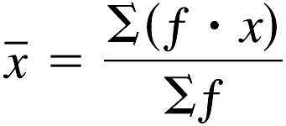
Mean from a Frequency
Distribution
use
class
midpoint
of
classes
for
variable x
Class Mid point
12

Slide 13
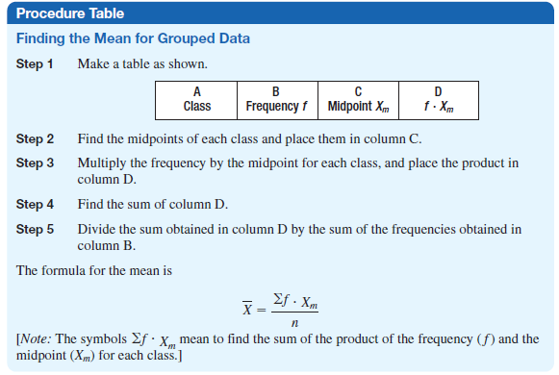
13

Slide 14
Probabilistic and Statistical Techniques
Measures of Variation

Slide 15
Probabilistic and Statistical Techniques
Key Concept
Because this section introduces the concept of variation, which is something so important in statistics, this is one of the most important sections in the entire book.

Slide 16
Probabilistic and Statistical Techniques
Definition
The range of a set of data is the difference between the maximum value and the minimum value.
Range = (maximum value) – (minimum value)
The range is very easy to compute but because it depends on only the highest and the lowest values, it isn't as useful as the other measures of variation that use every value.

Slide 17
Probabilistic and Statistical Techniques
Sample Standard Deviation
The standard deviation of a set of sample values is a measure of variation of values about the mean.
Sample Standard Deviation Formula

Slide 18
Probabilistic and Statistical Techniques
Sample Standard Deviation (Shortcut Formula)

Slide 19
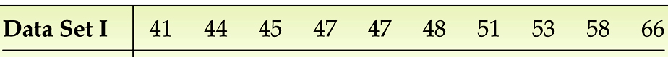
Probabilistic and Statistical Techniques
Example 3
For the data set determine: Standard deviation
 | x | x²
 | 41 | 1681
 | 44 | 1936
 | 45 | 2025
 | 47 | 2209
 | 47 | 2209
 | 48 | 2304
 | 51 | 2601
 | 53 | 2809
 | 58 | 3364
 | 66 | 4356
Sum | 500 | 25494
Solution

Slide 20
Probabilistic and Statistical Techniques
Standard Deviation - Important Properties
The standard deviation is a measure of variation of all values from the mean.
The value of the standard deviation s is usually positive.

Slide 21
Probabilistic and Statistical Techniques
Standard Deviation - Important Properties
The value of the standard deviation S can increase dramatically with the inclusion of one or more outliers (data values far away from all others).
The units of the standard deviation S are the same as the units of the original data values.

Slide 22
Probabilistic and Statistical Techniques
Population Standard Deviation
This formula is similar to the previous formula, but instead, the population mean and population size are used.

Slide 23
Probabilistic and Statistical Techniques
Standard deviation from a Frequency Distribution
use class midpoint of classes for variable x
Class Mid point

Slide 24
Spot Speed Studies

Slide 27
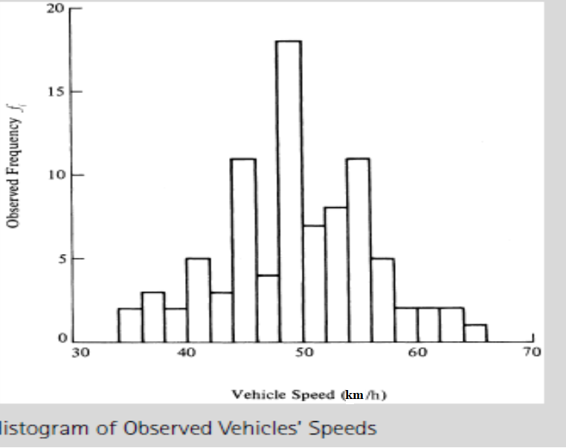
Spot Speed Studies

Slide 28
Spot Speed Studies

Slide 29
Spot Speed Studies

Slide 30
Spot Speed Studies

Slide 32
Probabilistic and Statistical Techniques
Definition
The variance of a set of values is a measure of variation equal to the square of the standard deviation.
Sample variance S²: Square of the sample standard deviation
Population variance : Square of the population standard deviation

Slide 33
Probabilistic and Statistical Techniques
Estimation of Standard Deviation
For estimating a value of the standard deviation s,
Use
Where range = (maximum value) – (minimum value)

Slide 34
Probabilistic and Statistical Techniques
Range Rule of Thumb
For Interpretation: If the standard deviation is known, we can use it to find rough estimates of the minimum and maximum ‘usual’ sample values as follows:
minimum usual value (mean) - 2 * (standard deviation)
maximum usual value (mean) + 2 * (standard deviation)

Slide 35
Probabilistic and Statistical Techniques
Example
Results from the National Health survey show that the heights of men have a mean of 69 in and a standard deviation of 2.8 in. use the range rule of thumb to find the minimum and maximum usual heights.
minimum usual value = (mean) - 2 * (standard deviation)
= 69 -2*2.8 = 63.4 in
maximum usual value = (mean) + 2 * (standard deviation)
= 69+2*2.8 = 74.6 in

Slide 36
Probabilistic and Statistical Techniques
Definition
Empirical Rule
For data sets having a distribution that is approximately bell shaped, the following properties apply:
About 68% of all values fall within 1 standard deviation of the mean.
About 95% of all values fall within 2 standard deviations of the mean.
About 99.7% of all values fall within 3 standard deviations of the mean.

Slide 37
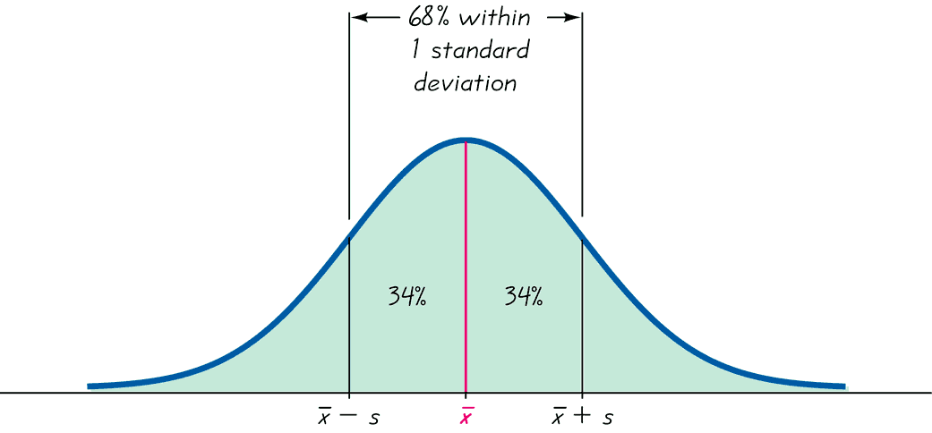
Probabilistic and Statistical Techniques
The Empirical Rule

Slide 38
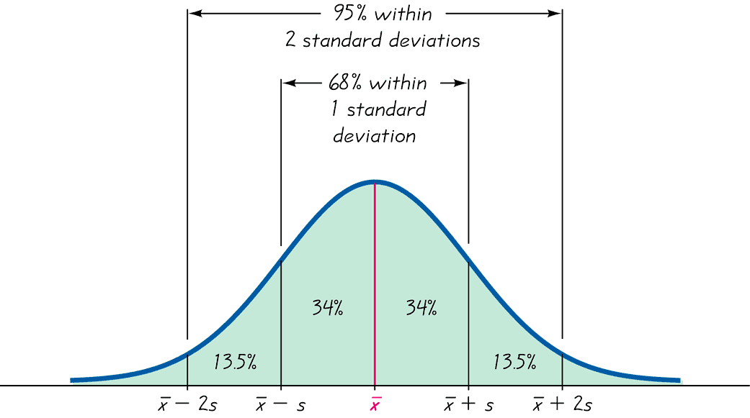
Probabilistic and Statistical Techniques
The Empirical Rule

Slide 39
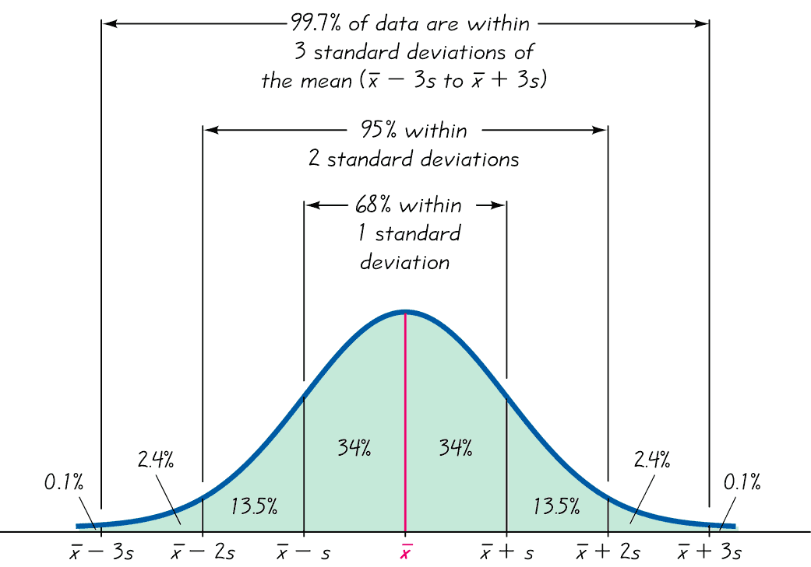
Probabilistic and Statistical Techniques
The Empirical Rule

Slide 40
Probabilistic and Statistical Techniques
Chebyshev Theorem
The proportion (fraction) of any set of data lying within K standard deviations of the mean is always at least 1-1/K² , where K is any positive number greater than 1. For K= 2 and K= 3, we get the following results.
At least 3/4 of the values lie within 2 s.d. of the mean
At least 8/9 of the values lie within 3 s.d. of the mean

Slide 41
Probabilistic and Statistical Techniques
Definition
The coefficient of variation (or CV) for a set of sample or population data, expressed as a percent, describes the standard deviation relative to the mean.
Sample
Population

